Slide 1
Profiling Potential Recruits
Tess Hart and Sam Richards
February 2018

Slide 2
Project Goals
To Profile Potential Military Recruits
Students who said they probably won’t serve the military
Discover key differences between potential recruits and other recruit groups
Develop recommendations for recruiting strategies for potential recruits
Develop recommendations for promotional messages for potential recruits

Slide 3
Dataset Overview
Data pulled from the 2016 Monitoring the Future survey through Institute for Social Research at University of Michigan
Survey was given to high schools seniors across U.S.
Survey was funded by National Institute on Drug Abuse
Big focus on drug, alcohol, and tobacco use

Slide 4
Primary Variables
Demographic characteristics
Students’ values (that is, what they consider to be important in life)
Satisfaction with various life domains
Student trustworthiness and fairness
Student relationship with government
Student ability to follow rules

Slide 5
Questions to be Answered
1. How big is the pool of potential recruits in the U.S. population of high school seniors?
2. What are the demographic characteristics of potential recruits?
3. In terms of the primary variables listed above, how do potential recruits differ from the other two groups in the sample? In what ways do they not differ?
4. Within the potential recruit group, are there gender differences in the variables studied?
5. Within the potential recruit group, are there racial differences (white vs non-white) in the variables studied?

Slide 6
How big is the pool of potential recruits in the U.S. population of high school seniors?

Slide 7
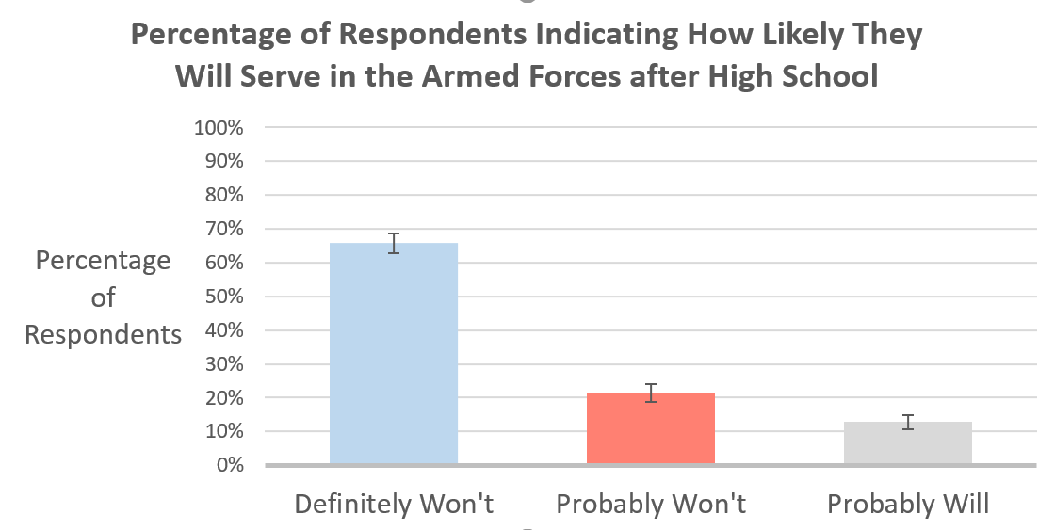
Size of Potential Recruit Pool
The potential recruit pool were students who stated that they probably will not served in the armed forces after high school.

Slide 8
What are the demographic characteristics of potential recruits?

Slide 9
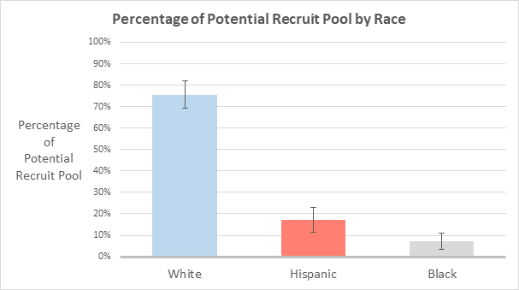
Race of Potential Recruits
The race breakdown of the potential recruit group was 75.6% white, 17.2% hispanic, and 7.2% black.

Slide 10
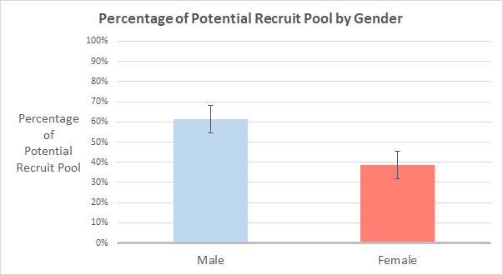
Gender of Potential Recruits
The gender breakdown of the potential recruit group was 61.5% male and 38.5% female.

Slide 11
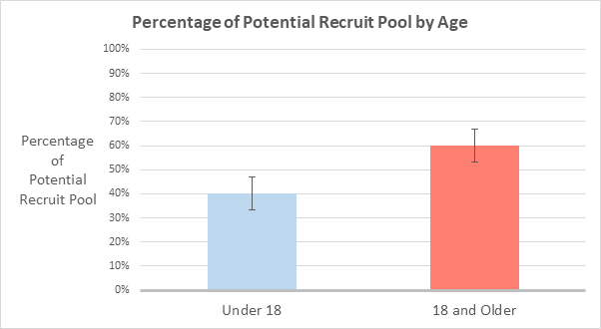
Age of Potential Recruits
The age breakdown of the potential recruit group was 40.1% under 18 years old and 59.9% 18 years or older.

Slide 12
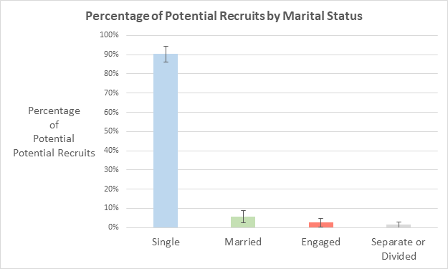
Marital Status of Potential Recruits
The marital status breakdown of the potential recruit group was 90.4% single, 5.5% married, 2.6% engaged, and 1.4% separated or divided.

Slide 13
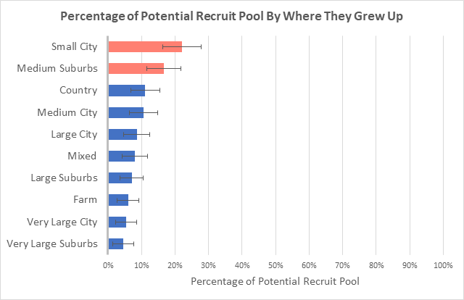
Area where Potential Recruits Grew Up
The breakdown of where the potential recruit group grew up is shown below in the graph.

Slide 14
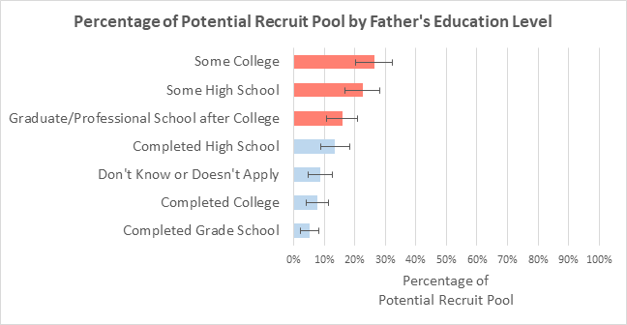
Father Education Level of Potential Recruits
The breakdown of father’s highest education level for the potential recruit group is shown below in the graph.

Slide 15
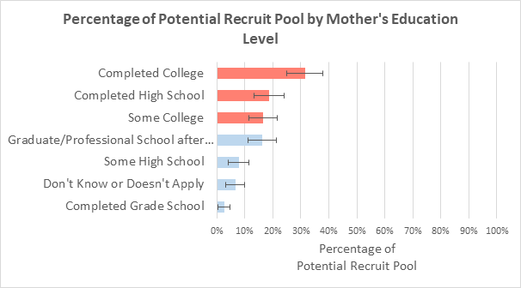
Mother Education Level of Potential Recruits
The breakdown of mother’s highest education level for the potential recruit group is shown below in the graph.

Slide 16
In terms of the primary variables listed above, how do potential recruits differ from the other two groups in the sample?

Slide 17
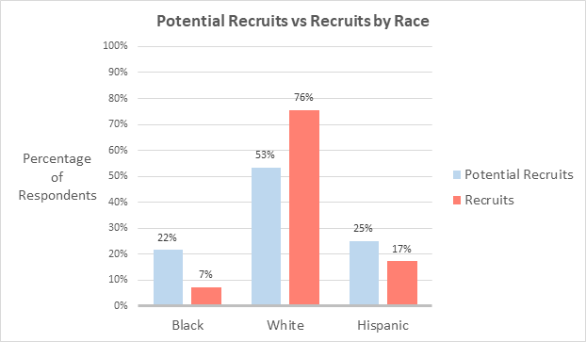
Race of potential recruits versus race of other students
The breakdown of race in the potential recruit group versus the breakdown of race ofother students is seen in the graph below:

Slide 18
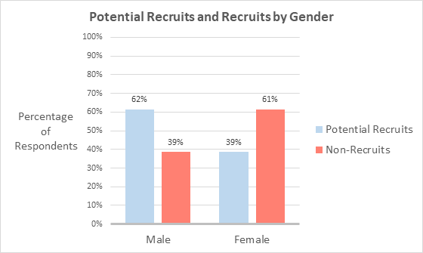
Gender of potential recruits versus other students
The breakdown of gender in the potential recruit group versus the breakdown of gender of other students is seen in the graph below:

Slide 19
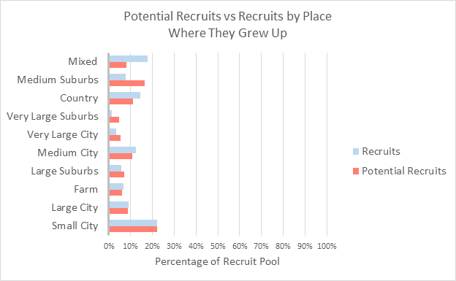
Place of origin of potential recruits versus other students
The breakdown of place of origin in the potential recruit group versus the breakdown of place of origin in the other students is seen in the graph below:

Slide 20
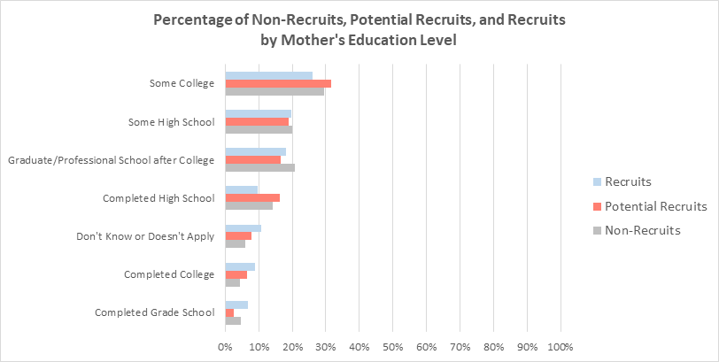
Mother’s education level of potential recruits versus other students
The breakdown of mother’s education level n the potential recruit group versus the breakdown of mother’s education level in the other students is seen in the graph below:

Slide 21
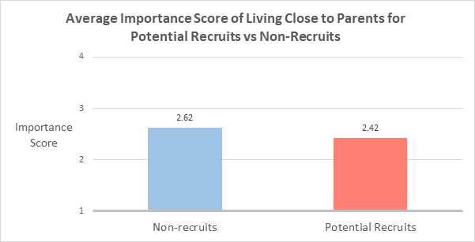
Importance of living close to parents for potential recruits versus other students
The breakdown of how important students found living close to parents differ between the potential recruit group and other students. The breakdown can be seen in the graph below:

Slide 22
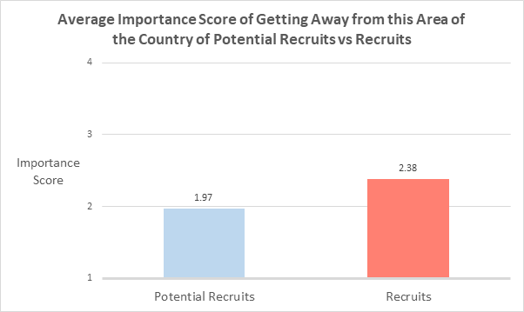
Importance of getting away from this area of the country for potential recruits versus other students
The breakdown of how important students found getting away from this area of the country differ between the potential recruit group and other students. The breakdown can be seen in the graph below:

Slide 23
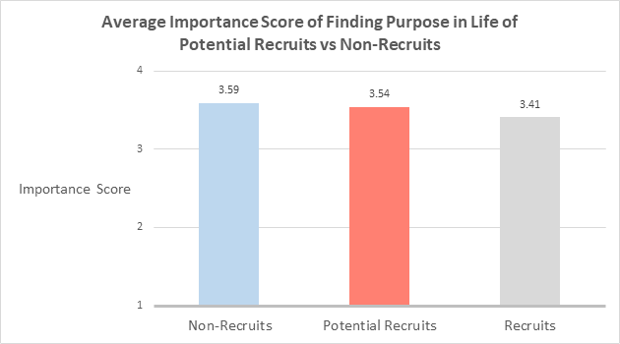
Importance of finding purpose in life for potential recruits versus other students
The breakdown of how important students found finding purpose in life differ between the potential recruit group and other students. The breakdown can be seen in the graph below:

Slide 24
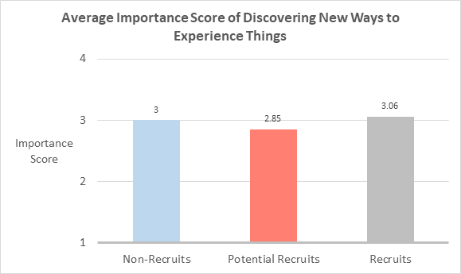
Importance of discovering new ways to experience things for potential recruits versus other students
The breakdown of how important students found discovering new ways to experience things differ between the potential recruit group and other students. The breakdown can be seen in the graph below:

Slide 25
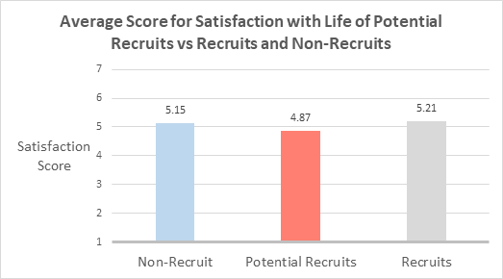
Satisfaction with life for potential recruits versus other students
The breakdown of how satisfied students were with life differ between the potential recruit group and other students. The breakdown can be seen in the graph below:

Slide 26
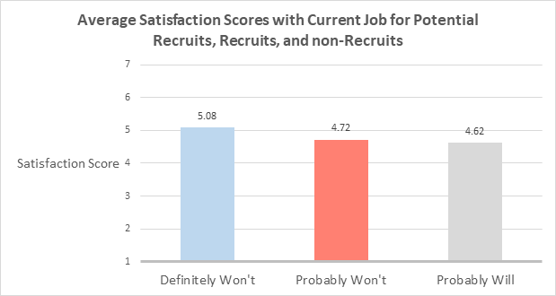
Satisfaction with current job for potential recruits versus other students
The breakdown of how satisfied students were with their current job differ between the potential recruit group and other students. The breakdown can be seen in the graph below:

Slide 27
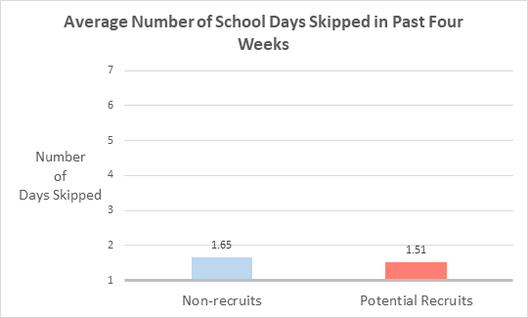
Number of days that students skipped school in the past four weeks for potential recruits versus other students
The breakdown of how many days students skipped school in the past four weeks differ between the potential recruit group and other students. The breakdown can be seen in the graph below:

Slide 28
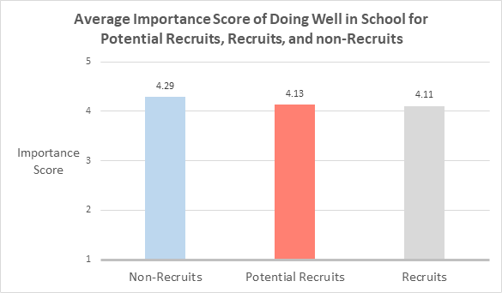
How much students thought doing well in school was important broken down by potential recruits versus other students
The breakdown of how much students thought doing well in school was important was different between the potential recruit group and other students. The breakdown can be seen in the graph below:

Slide 29
Within the recruit group, were there gender differences in the variables studied?

Slide 30
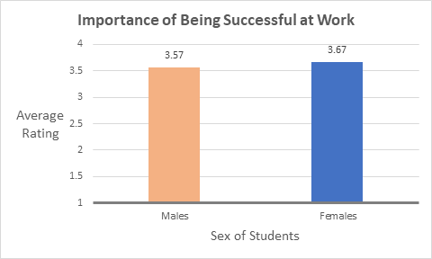
Importance of Being Successful at Work
Males on average thought it was more important to be successful at work than females did

Slide 31
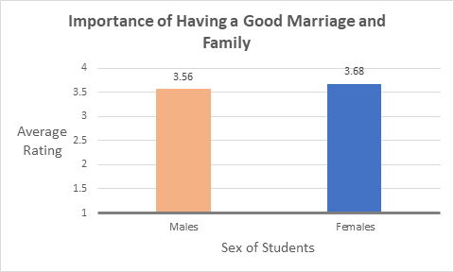
Importance of Having Good Marriage and Relationship with Family
Females on average thought it was more important to have a good marriage and family than males did

Slide 32
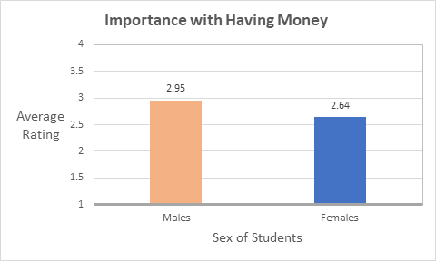
Importance of Having Lots of Money
Males on average thought it was more important to have lots of money compared to females.

Slide 33
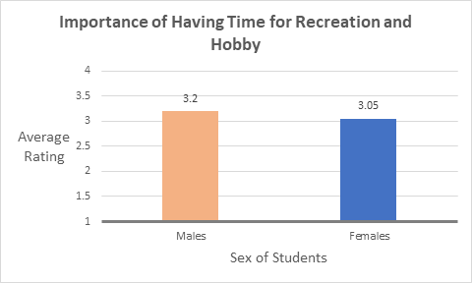
Importance of Getting Away from this Area of the Country
Females on average thought it was more important than males to get away from this area of the country.

Slide 34
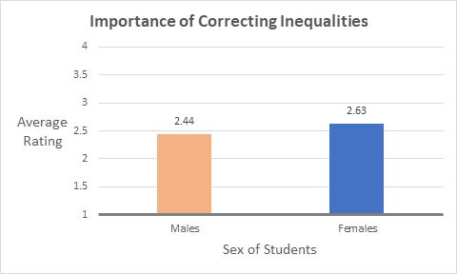
Importance of Correcting Inequalities
Females on average thought it was more important to correct inequalities than males did. .

Slide 35
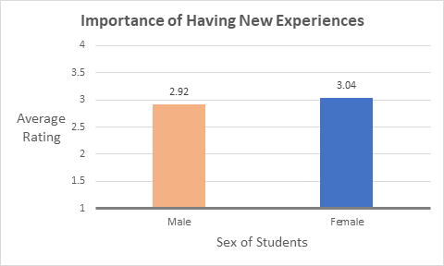
Importance of Having New Experiences
Females on average thought it was more important to have new experiences than males did. .

Slide 36
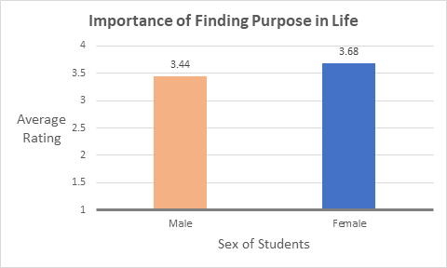
Importance of Finding Purpose in Life
Females on average thought it was more important to find purpose in life than males did. .

Slide 37
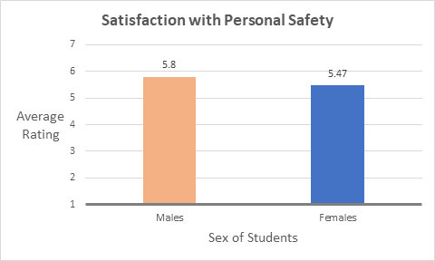
Satisfaction with Personal Safety
Males on average were more satisfied with their personal safety than females were.

Slide 38
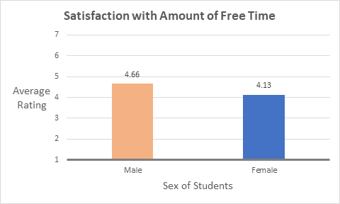
Satisfaction with Amount of Free Time
Males on average were more satisfied with their amount of free time than females were.

Slide 39
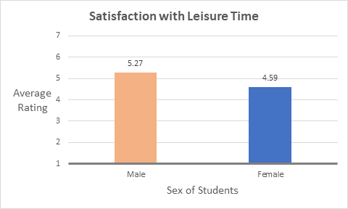
Satisfaction with Leisure Time
Males on average were more satisfied with how they spent their leisure time than females were.

Slide 40
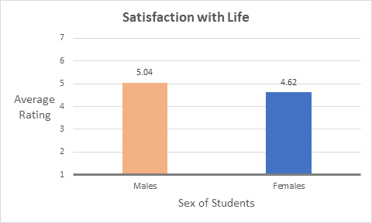
Satisfaction with Life
Males on average were more satisfied with life as a whole than females were.

Slide 41
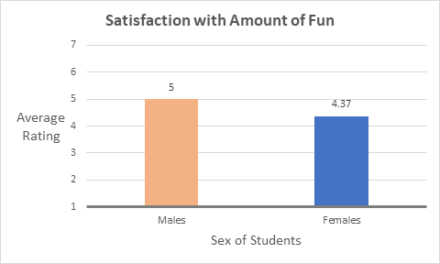
Satisfaction with Amount of Fun
Males on average were more satisfied with the amount of fun they have than females were.

Slide 42
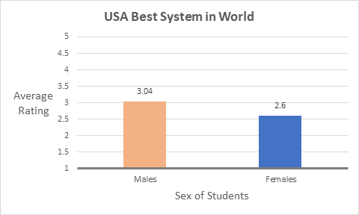
Agreement with the Statement:
“Our system is the best in the world”
Males on average agreed more that our system is the best in the world compared to females.

Slide 43
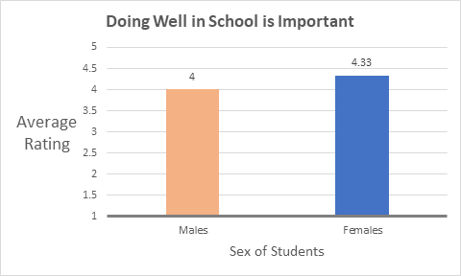
Agreement with the Idea that:
“Doing well in school is important”
Females on average thought more strongly that doing well in school is important than males did.

Slide 44
Within the recruit group, were there racial differences in the variables studied?

Slide 45
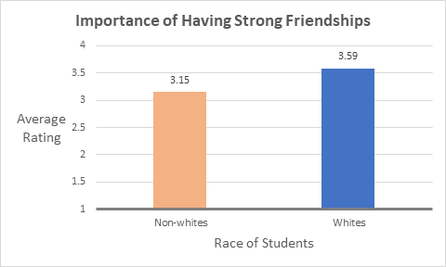
Importance of Having Strong Friendships
On average, whites thought it was more important to have strong friendships than non-whites did.

Slide 46
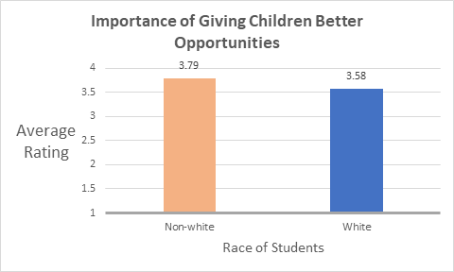
Importance of Giving Children Better Opportunities
On average, non-whites thought it was more important to be able to give their children better opportunities than whites did.

Slide 47

Importance of Correcting Inequalities
On average, non-whites thought it was more important to correct inequalities than whites did.

Slide 48
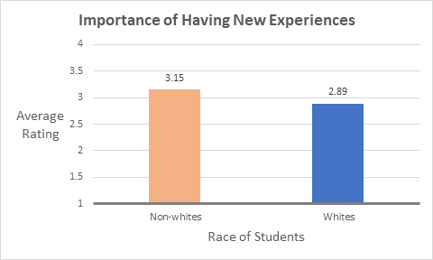
Importance of Having New Experiences
On average, non-whites thought it was more important to have new experiences than whites did.

Slide 49
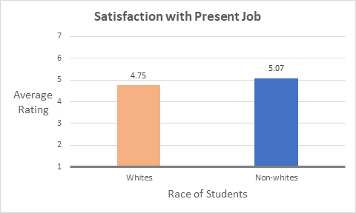
Satisfaction with Present Job
On average, whites were more satisfied with their present jobs than non-whites were.

Slide 50
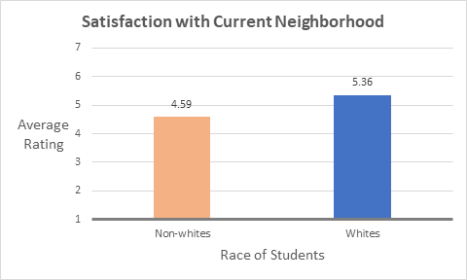
Satisfaction with Current Neighborhood
On average, whites were more satisfied with their current neighborhood than non-whites were.

Slide 51
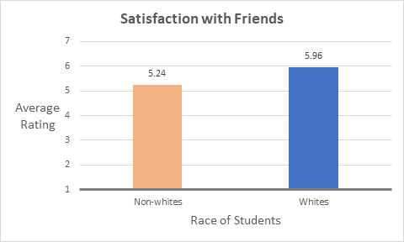
Satisfaction with Friends
On average, whites were more satisfied with their friends than non-whites were.

Slide 52

Satisfaction with Standard of Living
On average, whites were more satisfied with their standard of living than non-whites were.

Slide 53
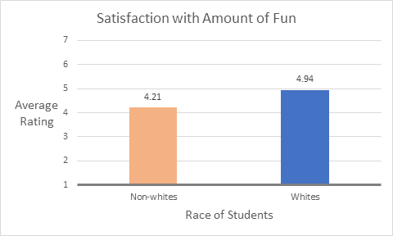
Satisfaction with Amount of Fun
On average, whites were more satisfied with their amount of fun than non-whites were.

Slide 54
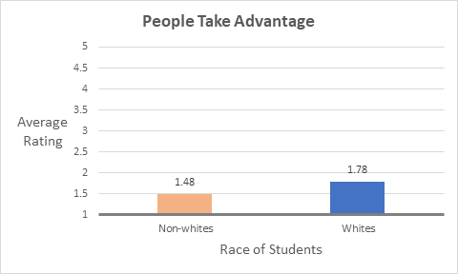
Agreement with the Statement that:
“People will take advantage if given the opportunity”
On average, whites thought more strongly that people will take advantage of others if given the opportunity.

Slide 55
Recommendations for Recruiting Strategies
Commercials showing travel, financial benefits, and strong bonds being formed through enlisting
Really hitting on the fun experiences that can be had while being in the military and the friendships made
Presentations at the schools about how joining betters one’s life and gives purpose
Messages that highlight diversity will attract the potential recruit group
Promotional materials should demonstrate the benefits of getting outside of one's comfort zone

Slide 56
Recommendations for Promotional Messages
Targeting white males will be critical in getting a large number to join the armed forces from the potential recruit group
To target males in the potential recruit group, focus on country pride, financial benefits, and spending free time with fellow military members
To target females in the potential recruit group, focus on travel experiences and having a life full of purpose through enlisting
To target whites, focus on strong friendships that will be formed
To target non-whites, focus on them getting to meet new friends with trustworthy individuals and getting out of their current neighborhoods
To target the potential recruit group as a whole, it will be key to display ways that joining can make life better

